Slide 1

Dawon
-COPHYFIT

Slide 2

About us
At Dawon, we are a group of sport scientists, IT Developers, sensor integration and Physical age-tech specialists. Dawon simplifies healthy ageing with integrated physical health-tech — from personalized programs to remote healthcare services, all designed to keep people live longer, active, confident, and connected while ageing.

Slide 3

Problem
Many elderly people are away from their kids, family, or are living alone. They crave social interaction, but this is missing
→ Reducing their mental health.
Due to age limitations, they cannot go to sports halls or labs in rural areas
→ Reduced independent living, and higher fall risk.
Caregivers face an increasing manual burden.
→ Elderly in care homes often lack enjoyment and social interaction

Slide 4
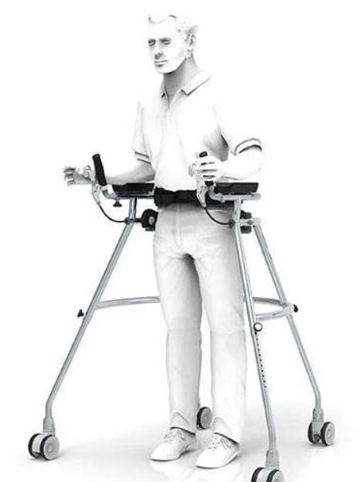
Solution
Solution - COPHYFIT
Integration with other Tech Devices at home, clinics, and rehabilitation centres.
Posture Supporting Design.
Symptom assessment and management.
Customized Exercise Program Information
Fall Detection System (Safety & Emergency Assistance).
Feedback mechanisms.
Social Inclusion Platform (Social Interaction & Remote Health Care Services).

Slide 5
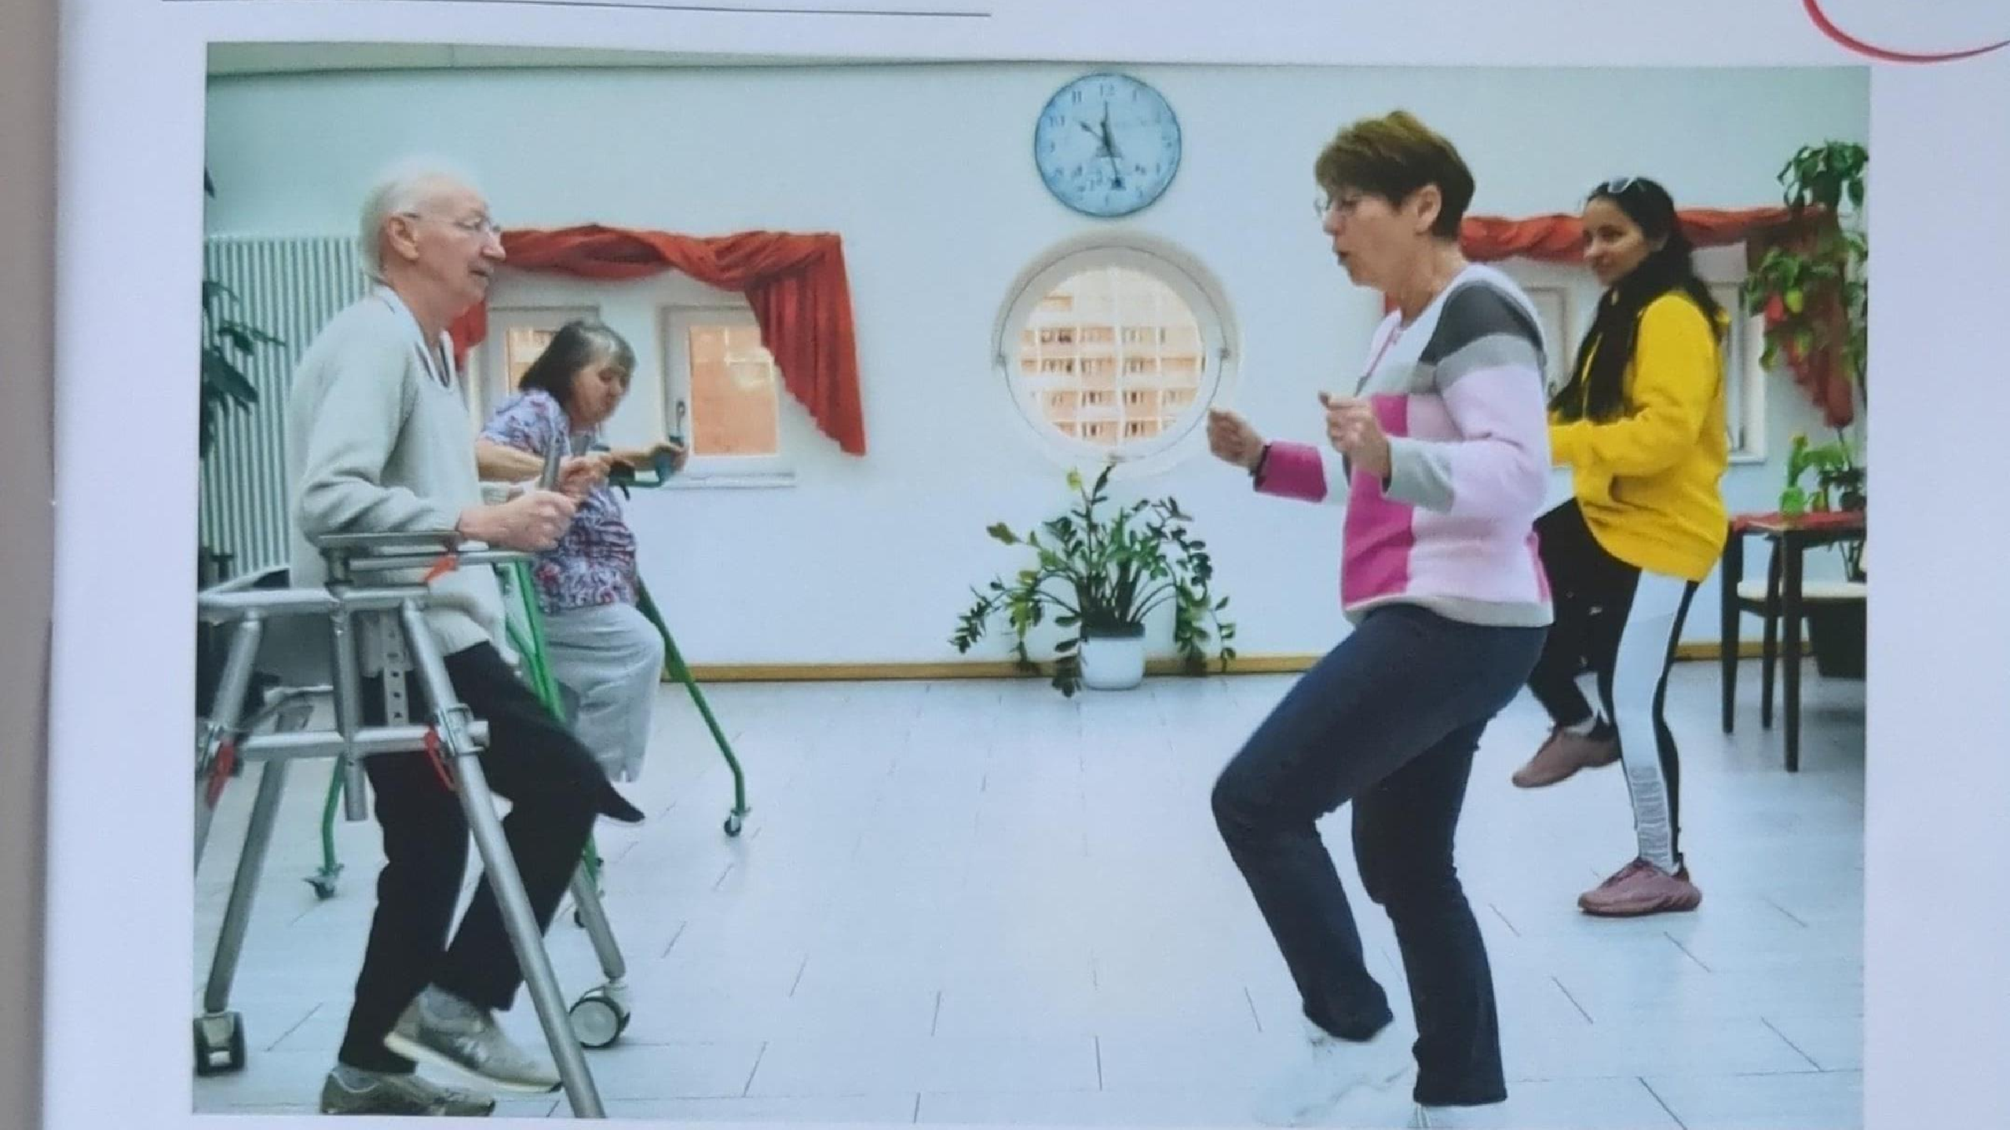
Who Will Benefit??
Elderly Users :
Lives alone in Magdeburg, feels isolated.
Wants safe mobility + fun, social activities.
HappyAge gives her: dance, movement, and connection.
Caregivers & Therapists :
Works in a care home.
Needs engaging rehab activities & easy progress tracking.
HappyAge saves her time and motivates her patients.
Families :
Daughter worried about her mother’s health.
Wants her active, safe, and happy.
HappyAge app shows her progress & reduces anxiety.
Care Homes & Clinics:
Need affordable, modern activity programs.
HappyAge offers ready-to-use solution with data feedback.

Slide 6
Competitive Situation
Fitness / Wellness Apps
(Peloton, Silver Sneakers, YouTube fitness)
Health-Tech Startups
(fall-detection wearables, smart walkers)
Great content, but not specifically tailored for the elderly, and lacks mobility integration.
Narrow focus (sensors only), no fun/social engagement.
(Rebotec, Drive DeVilbiss, Topro)Strong distribution.
Only focuses on hardware
Traditional Rollator Companies

Slide 7
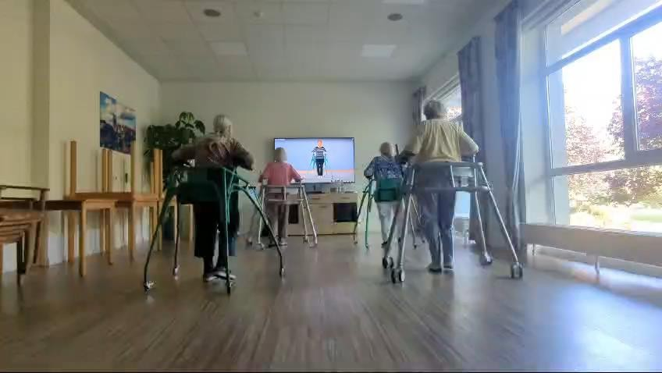
Key Differentiators
Differentiator 1
Only solution combining hardware + interactive content +health feedback + social fun.
Differentiator 2
Focused on the elderly niche, not general fitness.

Slide 8
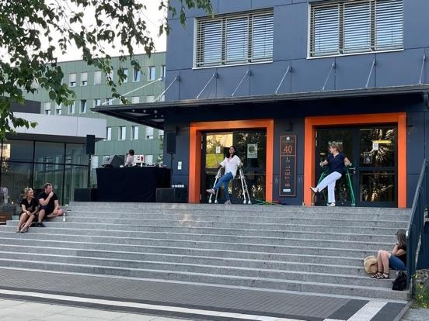
Business model
Subscription Based
Digitalisation of Intervention reduce Manual Burden and Enhances the Knowledge Transfer for longer Periods and Larger Audience
Rental Based
Renting the Hardware is Primary Option to Reduce Waste
Business to Business
Selling Rollators to Care Homes in Package of Five Subscriptions to One Rollator to accommodate More Users and helping Longevity of Elderly life

Slide 9
Growth Strategy
How we’ll scale in the future
DEC 2026 — Pilot & Validation
2028 — Regional Growth
OCT 2030 — National Expansion
Launch in regional care homes and rehab centers to gather mobility data and validate product-market fit.
Expand across Saxony-Anhalt and Berlin with care-home partnerships and therapist dashboards.
Integrate medical feedback, strengthen outcomes, and scale nationally through healthcare providers and insurers.

Slide 10
Traction
Forecasting for success​
Metrics
Year | Rentals (€15/mo) | Subscriptions (€150/yr) | Direct Sales (€360) | Gross Revenue
2027 | €12,600 | €30,000 | €36,000 | €78,600
2028 | €36,000 | €75,000 | €180,000 | €291,000
2029 | €54,000 | €120,000 | €252,000 | €426,000
2030 | €180,000 | €900,000 | €1,080,000 | €2,160,000
2031 | €216,000 | €1,125,000 | €1,260,000 | €2,601,000
Starting with a pilot in 2027, the company rapidly expands regionally and then nationally, reaching €2.6M in annual revenue by 2031, powered by strong subscription adoption and predictable recurring income.

Slide 11
Financials
Income | Year 1 (2027) | Year 2 (2028) | Year 3 (2029)
Users (Active Seniors) | 270 | 700 | 1,100 | ​
Sales (Rollators Sold) | 100 units | 500 units | 700 units | ​
Average price per sale | €360 | €360 | €360 | ​
Subscription Users | 200 | 500 | 800 | ​
Rental Units | 70 | 200 | 300 | ​
Revenue | €78,600 | €291,000 | €426,000 | ​
GROSS PROFIT (approx. 65%) | €51,000 | €189,000 | €277,000 | ​
Expenses | Year 1 | Year 2 | Year 3 | % of Revenue
Sales & Marketing | €20,000 | €70,000 | €110,000 | 40–50%
Customer Service & Support | €8,000 | €20,000 | €32,000 | ~10%
Product Development | €12,000 | €30,000 | €45,000 | ~10%
Research + Content Production | €5,000 | €12,000 | €18,000 | ~5%
TOTAL EXPENSES | €45,000 | €132,000 | €205,000

Slide 12
Five-year action plan
Finishing Certification, Selling Manual Rollators
Prototype Production
Company Registration
2026
Jan
Feb
Mar
Apr
May
Jun
Jul
Aug
Sep
Oct
Nov
Dec
Pilot Market Sales
Regional launch​
Collaboration With Insurance Companies
2027
Jan
Feb
Mar
Apr
May
Jun
July
2028
Aug
Sep
Oct
Nov
Dec
2030

Slide 13
Funding
30,000 Euros
14,000 Euros
Exist Grundstipendium
Angel investments​
Sale​
Funding Obtained From university
Amount obtained through other investors​
Selling Products from 2027

Slide 14
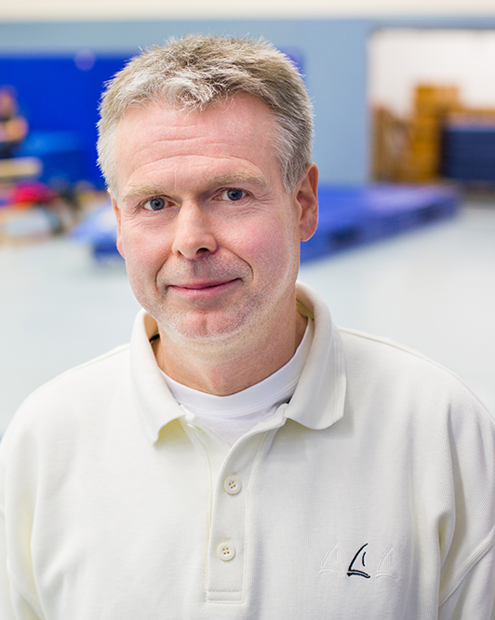
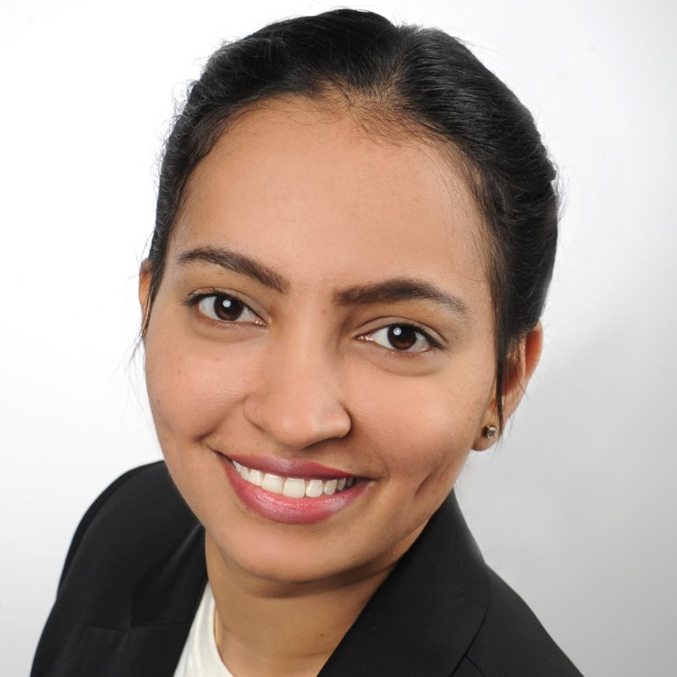
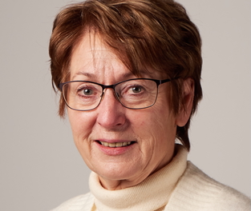
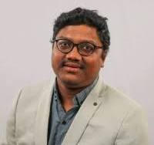
Meet the team
Prof. Dr. Edelmann Nusser​
M.Sc. Niharika Bandaru
Mentor​
Founder, Team Co-ordinator
Prof. DR.
aNITA Hökelmann
M.Sc. Janardhan
Team Member
Founder, Scientific Collaborator

Slide 15
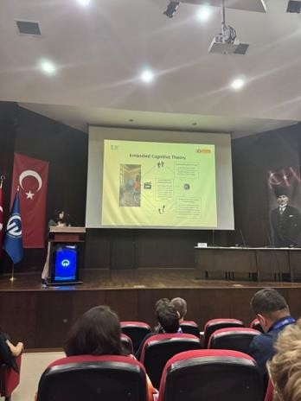
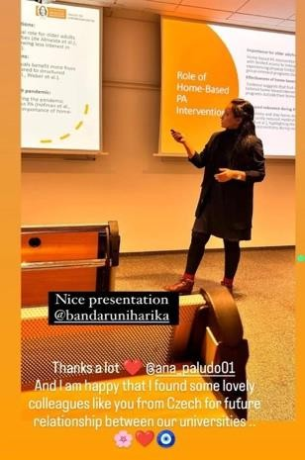
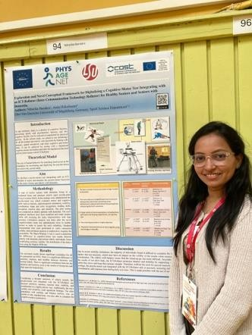
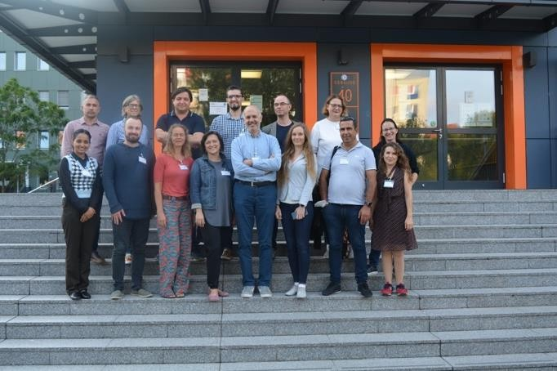
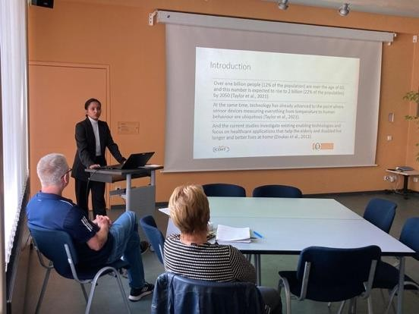
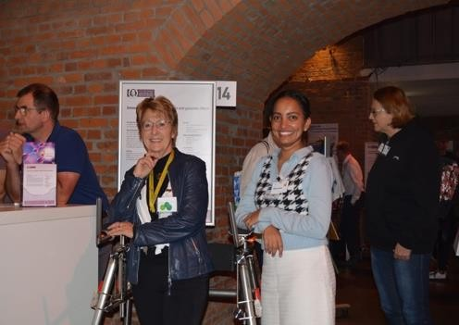
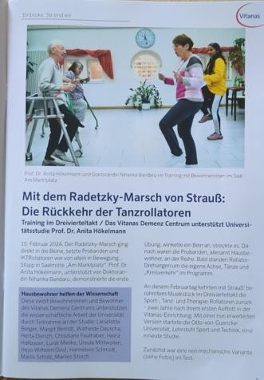
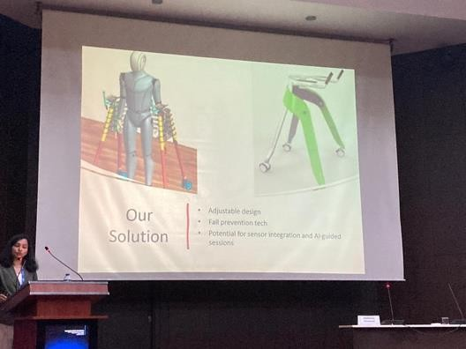
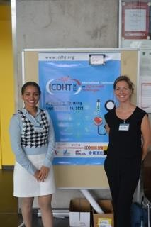
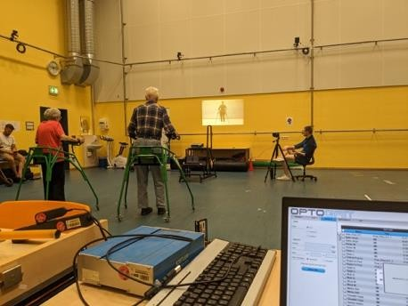
Trainer at the two Training Schools (Bruno & Ankara)
Two EGREPA
Conferences
( poster + Oral Presentation)
Cost Action Two articles with other Researchers
Portugal(Oral Presenter)
Parkinsons
Online conference
Organiser ICDHT Conference
Two care home studies

Slide 16
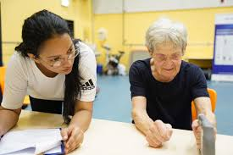

Services with our Innovative Products
Medication Management
Personal Health Monitoring
Remote Health Care Services
Access to Information and Resources Social Interaction and Mental Wellbeing

Slide 17
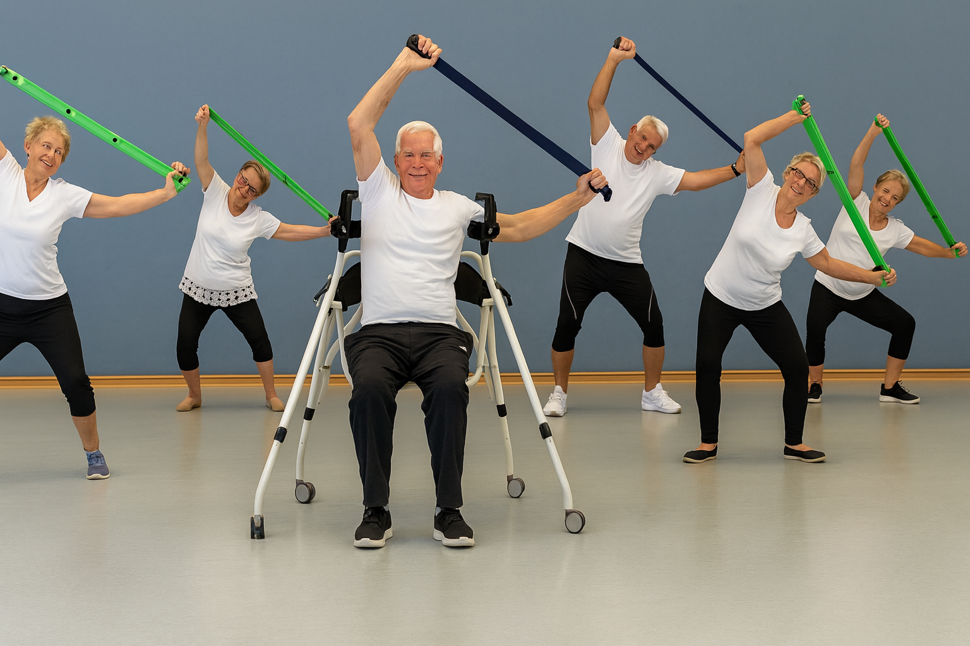
Thank you

